Slide 1
Domain Modeling
CIDM 4390/6330
Spring 2021

Slide 2
Domain Model?
Illustrates meaningful conceptual classes in problem domain
Represents real-world concepts, not software components
Software-oriented class diagrams will be developed later, during design
Intensions
Extensions

Slide 3
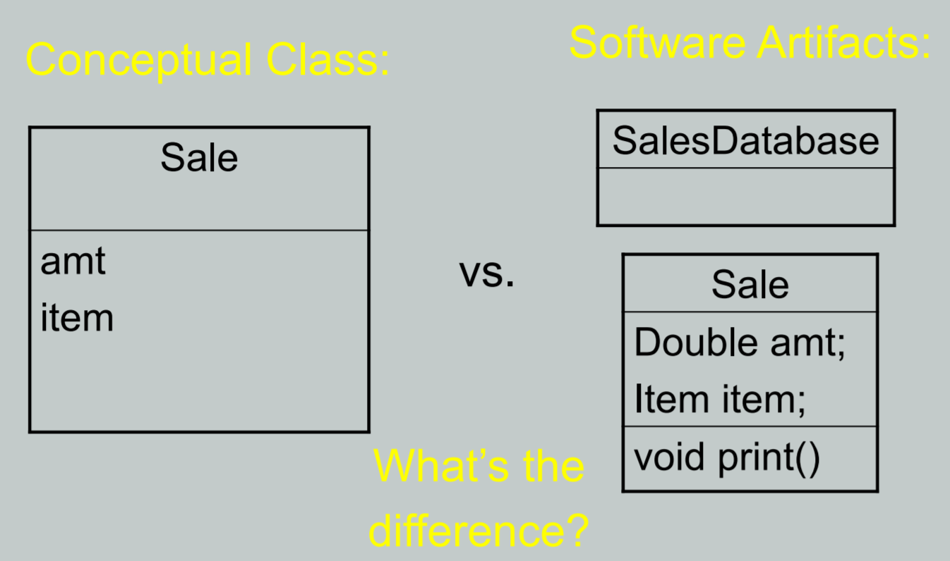
A Domain Model is Conceptual, not a Software Artifact

Slide 4
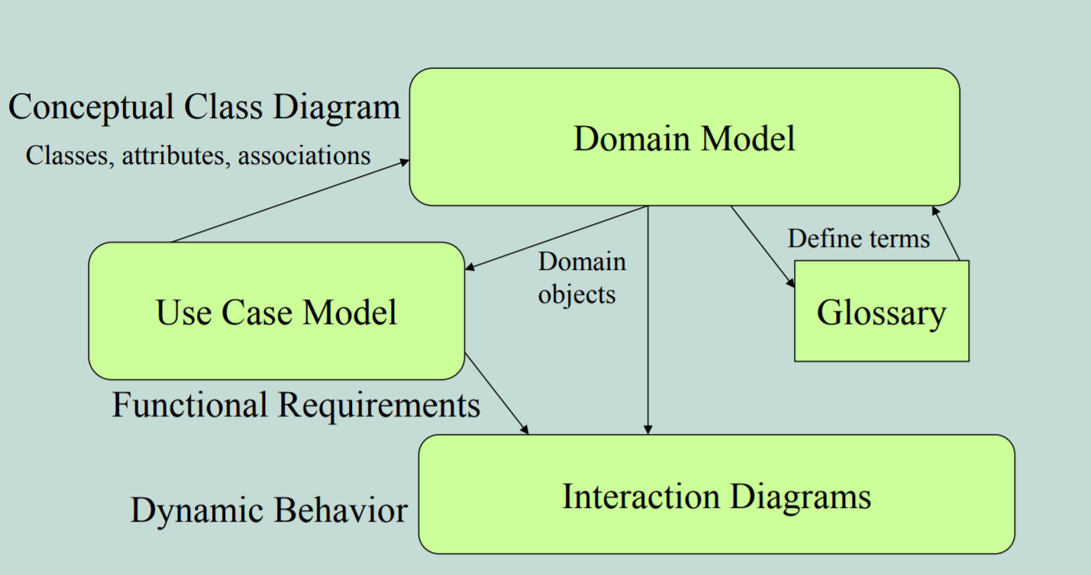
Common Relationships

Slide 5
Purpose of Domain Modeling
Gives a conceptual framework of the things in the problem space
Helps you think – focus on semantics
Provides a glossary of terms – noun based
It is a static view - meaning it allows us convey time invariant business rules
Foundation for use case/workflow modelling
Based on the defined structure, we can describe the state of the problem domain at any time.

Slide 6
Features of a domain model
Domain classes – each domain class denotes a type of object.
Attributes – an attribute is the description of a characteristic or property of a specified type (think datatype) in a domain class; each instance of the class separately holds a value.
Associations – an association is a relationship between two (or more) domain classes that describes links between their object instances.
Associations can have roles describing the multiplicity and participation of a class in the relationship.
Additional rules – complex rules that cannot be shown with symbolically can be shown with attached notes.

Slide 7
Domain Classes
Each domain class denotes a type of object. It is a descriptor for a set of things that share common features.
Classes can be:
Business objects - represent things that are manipulated in the business e.g. Order.
Real world objects – things that the business keeps track of e.g. Contact, Site.
Events that transpire - e.g. sale and payment.

Slide 8
Identifying Domain Classes
Reuse an existing domain model
There are many published, well-crafted domain models.
Use a conceptual class category list
Make a list of all candidate conceptual classes
Identify noun phrases
Identify nouns and phrases in textual descriptions of a domain (use cases, or other documents)

Slide 9
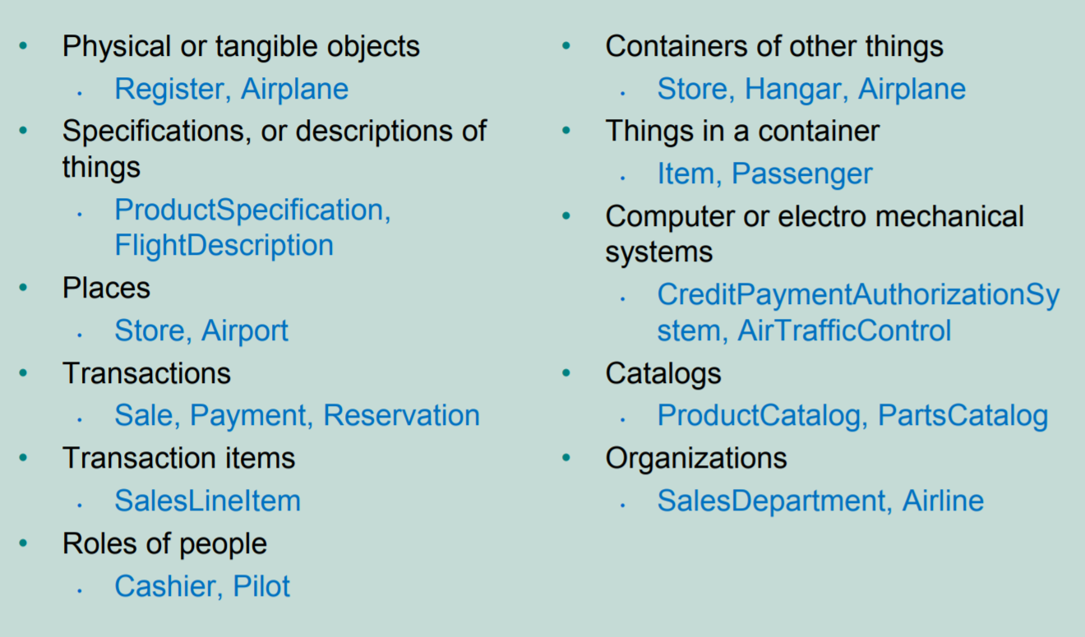
Conceptual Class Category List

Slide 10
Identify conceptual classes from noun phrases (NP)
Vision and Scope, Glossary and Use Cases are good for this type of linguistic analysis
• However:
Words may be ambiguous or synonymous
Noun phrases may also be attributes or parameters rather than classes:
If it stores state information or it has multiple behaviors, then it’s a class
If it’s just a number or a string, then it’s probably an attribute

Slide 11
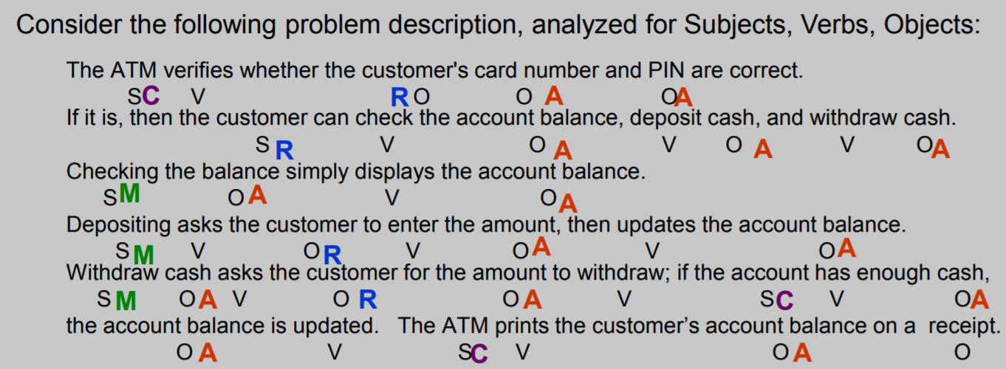
An Example from NPs to classes/attributes

Slide 12
Methodology
Analyze each subject and object as follows:
Does it represent a person performing an action?
Then it’s an actor, ‘R’.
Is it also a verb (such as ‘deposit’)?
Then it may be a method, ‘M’.
Is it a simple value, such as ‘color’ (string) or ‘money’ (number)?
Then it is probably an attribute, ‘A’.
Which NPs are unmarked?
Make it ‘C’ for class.
Verbs can also be classes, for example: Deposit is a class if it retains state information

Slide 13
Methodology (2)
Identify candidate conceptual classes
Draw them in a UML domain model
Add associations necessary to record the relationships that must be retained
Add attributes necessary for information to be preserved
Use existing names for things using the vocabulary of the domain

Slide 14
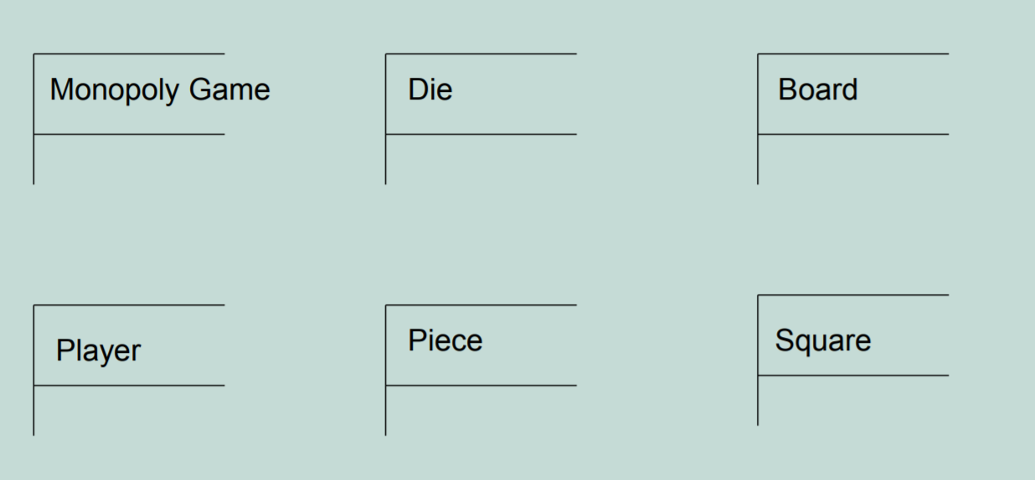
Revisiting the Monopoly Example

Slide 15
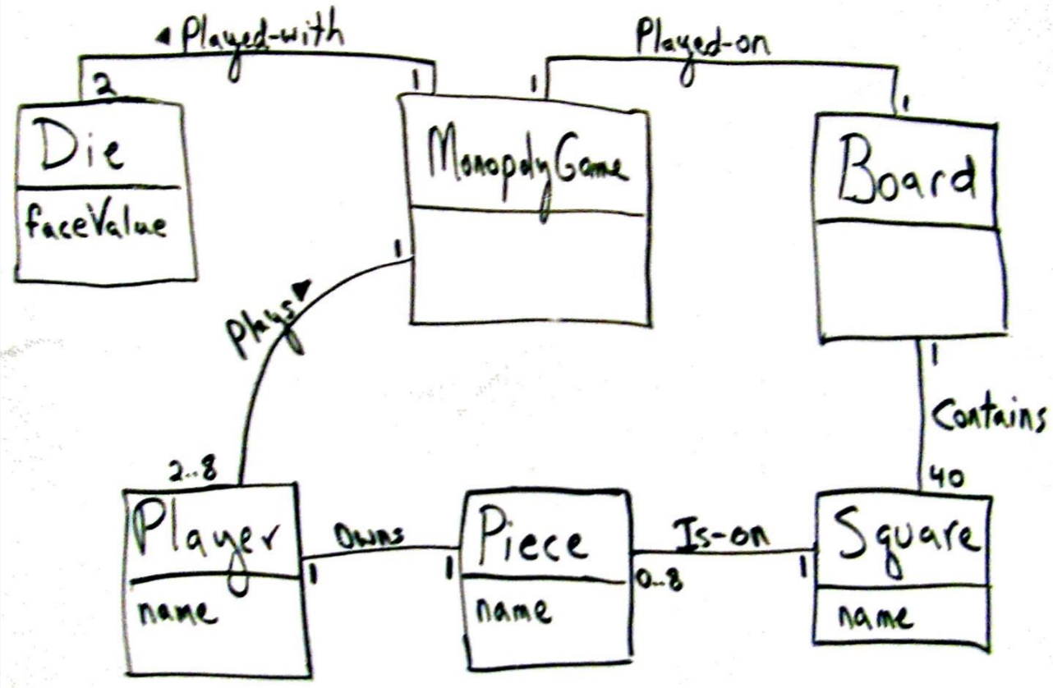
Monopoly Game Domain Model

Slide 16
Class Names
A Class Name creates the vocabulary of our analysis
Use nouns as class names, think of them as simple agents
Verbs can also be made into nouns, if they maintain state
Use pronounceable names:
If you cannot read the name aloud, it is not a good name
Use capitalization to initialize Class names and demarcate multi-word names
CardReader rather than CARDREADER or card_reader
Avoid obscure, ambiguous abbreviations
E.g., is TermProcess something that terminates or something that runs on a terminal?
Try not to use digits within a name, such as CardReader2
Better for instances than classes of objects

Slide 17
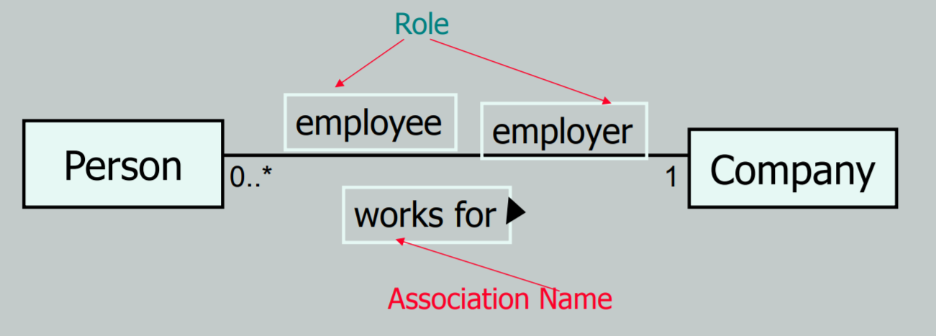
Associations
A link between two classes (“has a”)
Typically modeled as a member reference
A Person works for a Company
Role names and multiplicity are placed at association ends
Arrows aid reading of association name

Slide 18
Developing Associations
An association is a relationship between classes that indicates some meaningful and interesting connection.
In the UML, associations are defined as “the semantic relationship between two or more classifiers that involve connections among their instances.”

Slide 19
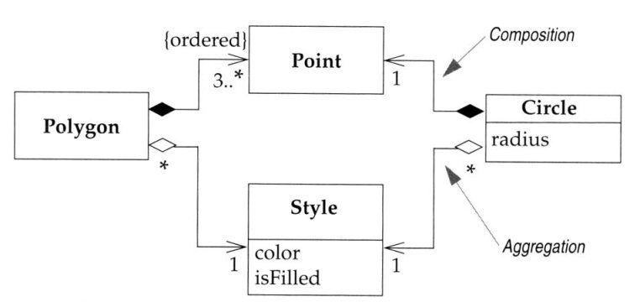
Common Associations
At a basic level, these are lines connecting classes
In UML, simple line is an association
We clarify and specify using decorations for
multiplicity
role names
constraints
Aggregations and composition:
Arrow denotes navigability
A black-filled diamond denotes a composition: a part, unique to this whole
A white-empty diamond denotes an aggregation: a part, but not unique to this whole

Slide 20
Aggregation and Composition

Slide 21
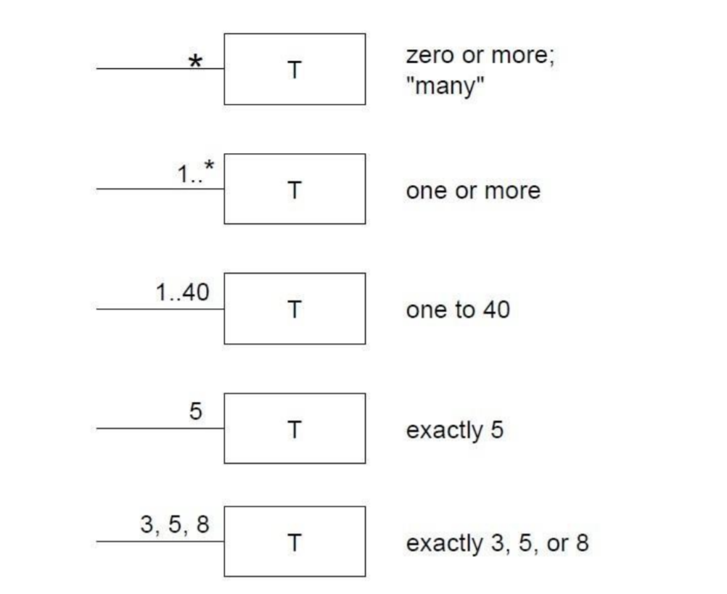
Roles and Multiplicity
Each end of an association is called a role.
Multiplicity defines how many instances of a class A can be associated with one instance of a class B.
e.g.: a single instance of a Store can be associated with “many”(zero or more) Item instances.

Slide 22

Adding Attributes
An attribute is a logical data value of an object.
Include the following attributes in a domain model: Those for which the requirements suggest a need to remember information.
An attribute can be a more complex type whose structure is unimportant to the problem, so we treat it like a simple type
UML Attributes Notation: Attributes are shown in the second compartment of the class box
Attributes

Slide 23
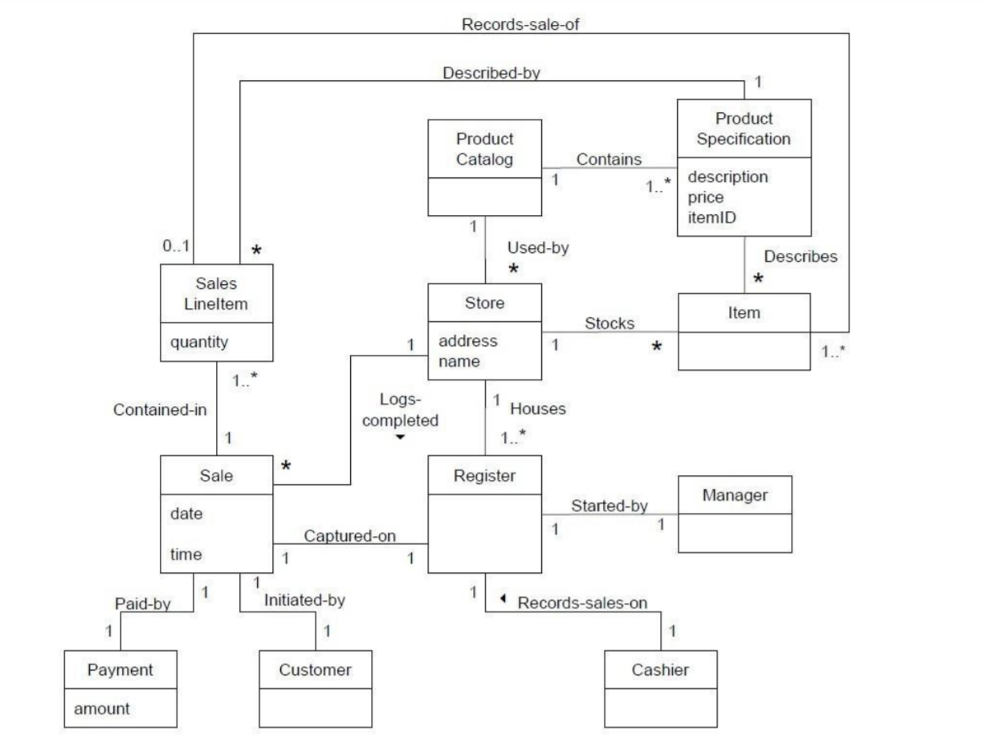
A Point-Of-Sale Domain Model

